Slide 1
COLUMBIA ASIA HOSPITAL
DS’OCT BATCH
(power bi newton project)
Pratik nANdanwar

Slide 2


INTRODUCTION
Columbia Asia hospital is a chain of hospitals
which started its operations in 1996.
The mission of the hospital is to provide accessible
and efficient medical services and serve the
respective communities.
Hospital aims to provide affordable healthcare with no
compromise on quality , with modern amenities and
highly trained teams of staff and doctors.
Columbia Asia medical facilities provide a wide array
of medical services such as
General Practice
Neurology
Cardiology
Orthopedics
Physiotherapy
Renal

Slide 3
OBJECTIVES
Suggestion regarding optimizing the patient experience by strategically analysing the data.
Establish and analyse relation between hospital metrics such as departments ,number of visits to
patient metrics such as age , ethnicity, demographics.
Study the seasonal patterns in change of volume of patients for pre planning of services.
Examine the patients response to existing hospital services so as to identify the
need and strategic direction for adding of services .
Suggestions for strategies and plans for establishing discount models based on data .
Identifying the departments for new hiring and staffing.

Slide 4
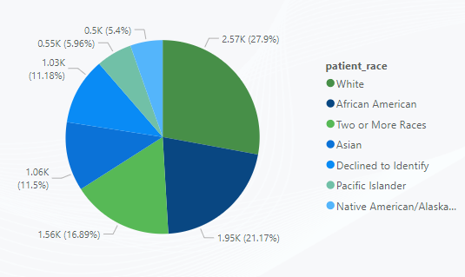
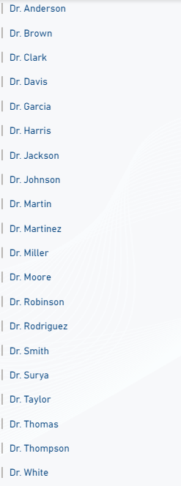
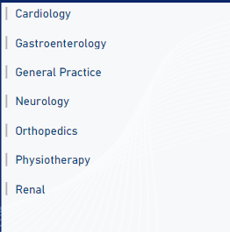
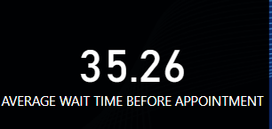
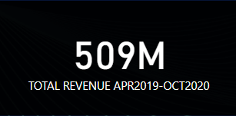
OVERVIEW OF DATA
TOTAL DOCTORS
22
NUMBER OF PATIENTS
9185
RACES OF PATIENTS AND THEIR DISRTIBUTION
TOTAL DEPARTMENTS
7
AVERAGE SATISFACTION SCORE - 5
AGE RANGE OF PATIENTS
1YR-79YRS
DURATION OF DATA RANGE AVAILABLE
APRIL 2019 –OCT 2020

Slide 5
METHODOLOGY
1-Data cleaning
Raw data source was cleaned using Power bi power queries & DAX functions to get more accurate results and insights and eliminate errors as well facilitate convenience.
2-Data analysis
The cleaned data was analysed in a objective & subjective manner using visualizations , aggregations & logics for deriving insights and making suggestions from it.
3- Deriving insights
Patterns and logics were observed in data & based on it definitive insights was derived for further suggestion and strategic planning.
4-Suggestions & advice for further operations.
The insights obtained was used to make prior strategic planning & management for achieving the objectives for a optimized experience.

Slide 6
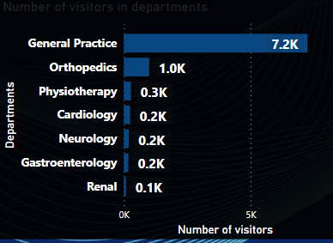
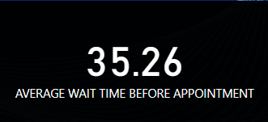
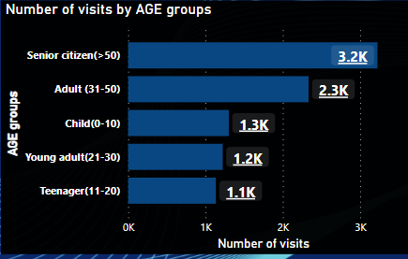
OBJECTIVE KEY FINDINGS
NUMBER OF VISITORS IN EACH DEPARTMENT
AVERAGE WAIT TIME FOR PATIENT
PATIENTS VISITS BY AGE GROUP
The number of visitors in each departments indicates about the load on department , volume of visitors categorically , market need for specific department.
This key finding would help to give management the direction for upgrades in departments.
Average wait time for patient indicates about the load ,efficacy of staff & services of hospital.
It should be aimed to lower the wait time for patient.
The age group distribution gives a insight about which age category of population visits more or less.
This would help to be preprepared for services establishment for respective age groups.

Slide 7
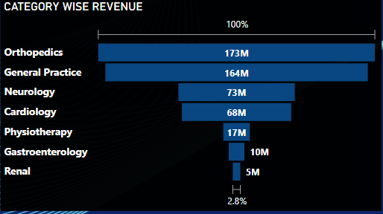
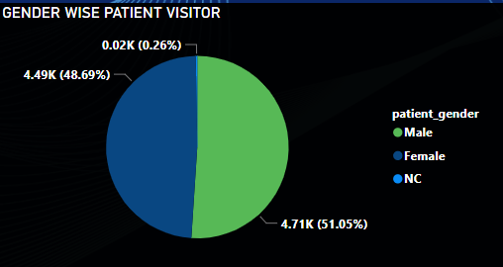
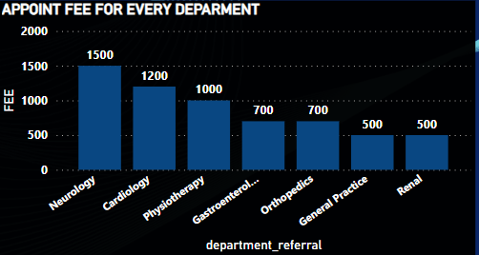
OBJECTIVE KEY FINDINGS
REVENUE DISTRIBUTION PER DEPARTMENT
VISITORS DSITRIBUTION AS PER GENDER
DEPARTMENT’S APOINTMENT FEES
This distribution of revenue as per departments helps in understanding the individual contribution of each department in the total revenue.
It can be observed that orthopaedics and general practice department is the major contributor to revenue of hospital.
This distribution of visitors categorised as per gender give insights about the load and visitor pattern at hospital as per gender.
It helps to understand if any pre-planning or upgrade in service is to be made according to gender .
This shows the department OPD appointment fee which would visualize which department is charging the highest.
This would help in planning the discounts for patients.

Slide 8
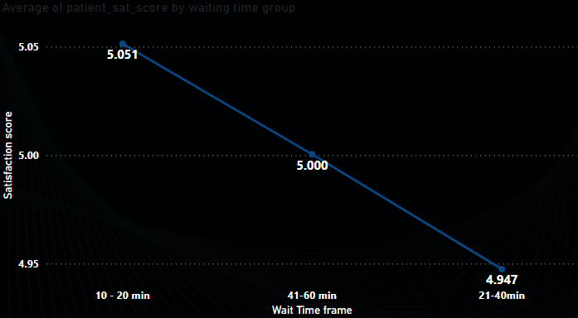
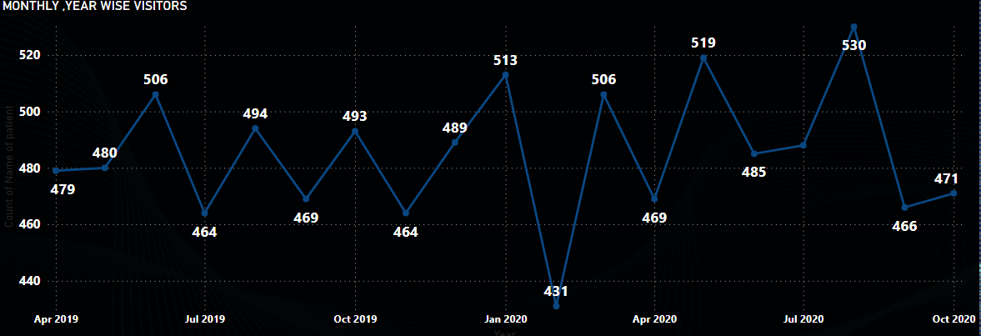
SUBJECTIVE KEY FINDINGS
SATISFACTION SCORE AS PER WAIT TIME
VISITORS AS PER MONTH & YEAR
It can be seen that wait time has inverse relationship with satisfaction of customer.
Hence hospital services and process should be updated to achieve minimum wait time for patient for optimizing patient’s hospital experience.
A pattern of steady number of average visitors over the year has been observed.
This indicates non exponential growth in the hospital.
Hence strategy for optimizing patient experience, lower wait time at hospital , age specific and respective services should be done.

Slide 9
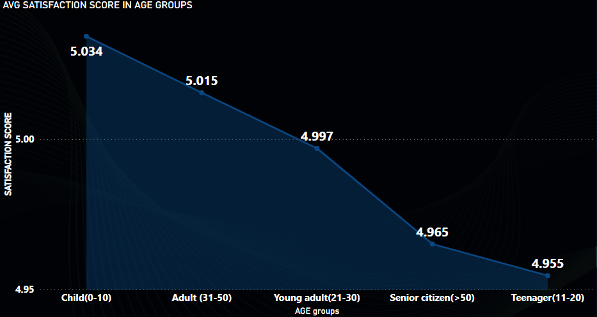
SUBJECTIVE KEY FINDINGS
SATISFACTION SCORE AS PER AGE GROUPS
KEY DATA FOR NEW HIRING OF DOCTORS
LOAD ON DEPARTMENT
CONTRIBUTION OF DEPARTMENT TO REVENUE
As obtained from graph, satisfaction for Senior citizen and teenager is observed to be the lowest.
This can be due to inadequate services for senior citizen as they need specialised services due to their age group. As well problems shall identified with teenager age groups.
It can be observed that general practice & orthopaedics department has the highest load amongst as well they are the major contributor to the revenue.
From the data we can see only 7 doctors handles this load for general practice & orthopaedics department.
Hence we can say that general practice & orthopaedics department would be the appropriate department for new hiring or doctors.

Slide 10
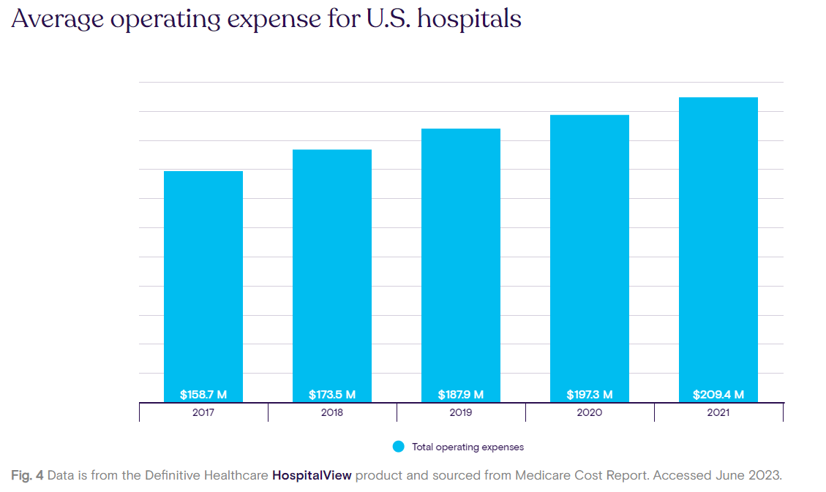
SUBJECTIVE KEY FINDINGS
ESTIMATION TO PROFITABLITY OF HOSPITAL
TOTAL REVENUE REPORTED FOR 17 MONTHS
OPERATING & OTHER COSTS(85% OF REVENUE)
430 M
EXPENSES
We can estimate that the hospital is profitable by the data extracted from Medicare cost report and data that was available to us.
We can use this profit fund for various service and welfare related updates in hospitals.
This fund can be strategically allocated to Research & development , hiring & training of new and existing staff, upgrade and maintenance of capital building.

Slide 11
STRATEGIC RECOMENDATIONS
Based on inverse relationship of average satisfactions score and wait time of patient services & upgrades like
optimization in appointment taking process, Integrating online and digital services, Training the staff,
effective resource allocation and availability should be done .
No exponential growth was noticed through out the year ,hence apart from the uncontrollable factors the factors
within hospital such as lack of services, high wait time , non ease for booking appointments, no specific age group
services and these gaps should be tackled by introducing and integrating -online & digital services, age specific
services , instant actions on the feedbacks from patient.
Satisfaction score for senior citizens and teenagers were observed to be low , this indicates that there is some lack
of services from the hospital side that this age group is reporting low satisfaction group.
This can be improved with age specific services to old age people like home or online doctor visits to old aged
people, Staff and hospital manpower should be trained specifically to cater to the every specific age group
depending upon their particular needs, effective & appropriate communication with teenagers.

Slide 12
STRATEGIC RECOMENDATIONS
Discount models should be practiced by the hospital which would serve the purpose of welfare for the community as
well the other major benefit of it would be it can provide tax benefits in the hospital revenue which would be
profitable for the hospital ultimately .
As the hospital revenue is estimated in a positive profitable side, planed percentage of funds can be allocated to
the various upgrades of the hospital like online & digital systems , carrying out advance research and development
working on providing more services to the patients, hiring more doctors which would lower the wait time of patient
as well increase the patients experience , opening a new department which is in market demand.

Slide 13
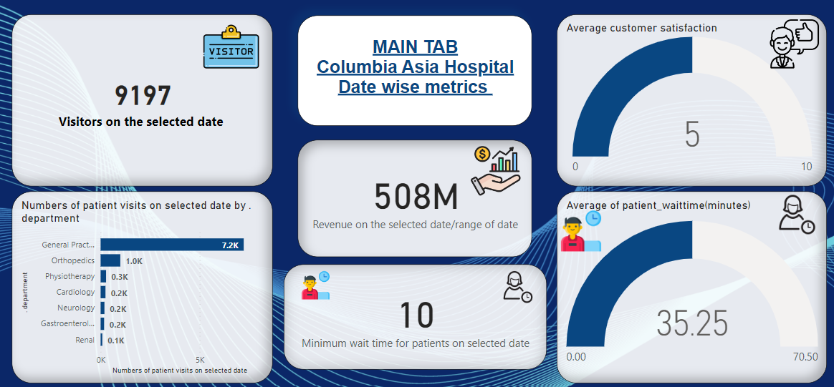
COLUMBIA ASIA HOSPITAL INFORMATION AT A GLANCE

Slide 14
CONCLUSION
Planning & efforts should be taken for optimizing patient overall experience for increasing average satisfaction score of 5 to 7—8 range.
The waiting time for patient should be aimed to reduced for achieving greater satisfaction score.
The number of visitors have not increased through the year , hence gap for should be by introducing and integrating -online & digital services, age specific services , instant actions on the feedbacks from patient
which would increase the satisfaction score of patient and ratings of hospital and help pulling more patient’s
towards the hospital.
Strategic planning for lowest reported satisfaction by age groups of senior citizen and teenagers should be done to increase it by the ideas specified in the report.
Hospital should create & adapt to new discount models ,which would serve the purpose of social welfare as well as savings and obtaining tax benefits.
Hospital should hire new doctors to department of general practice & orthopaedics due to the load of patient’s as well there contribution to revenue.

Slide 15
REFERENCES
GRAPH FROM THE REPORT- MEDICARE COST REPORT- Graph& report used to estimate average expenses for hospital.
https://www.definitivehc.com/blog/revenue-trends-at-u.s.-hospitals#:~:text=Average%20hospital%20operating%20expenses%20steadily,a%207%25%20increase%20each%20year.

